Slide 1




CENG CHECKERS
CME 1251 Project Based Learning
By:
Sefa Çelik 2020510078
Esma Beydili 2020510018
Mustafa İzzet Yumuşak 2020510075

Slide 2
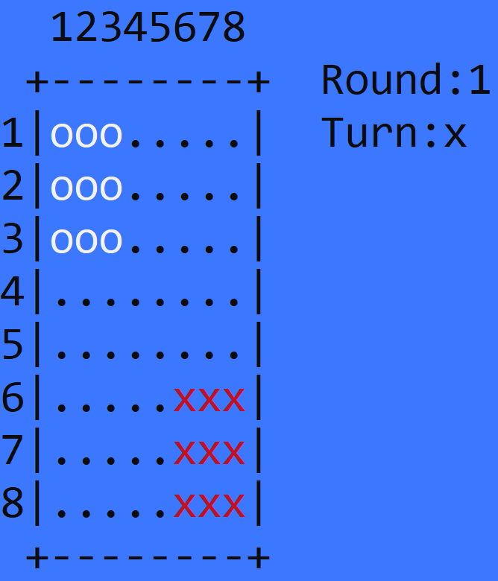
GENERAL EXPLANATION OF OUR GAME
8x8 gameboard
Two player (Computer x Human)
9 pieces for each player
Use step and jump moves
Settle into the computer zone before computer

Slide 3

Progress Summary
First Week
Screen array created and project process planned.
Second Week
Cursor moves, choosing piece and target, and step operation for human.
Third Week
Step operation for computer.
Fourth Week
Jump operation for human and computer.
Fifth Week
The poster and the presentation were prepared and the bugs in the game were searched.

Slide 4

Completed Tasks
Gameboard Created.
Step, jump, cursor moves for human; completed.
Step and jump for computer.
End of the game planned.

Slide 5
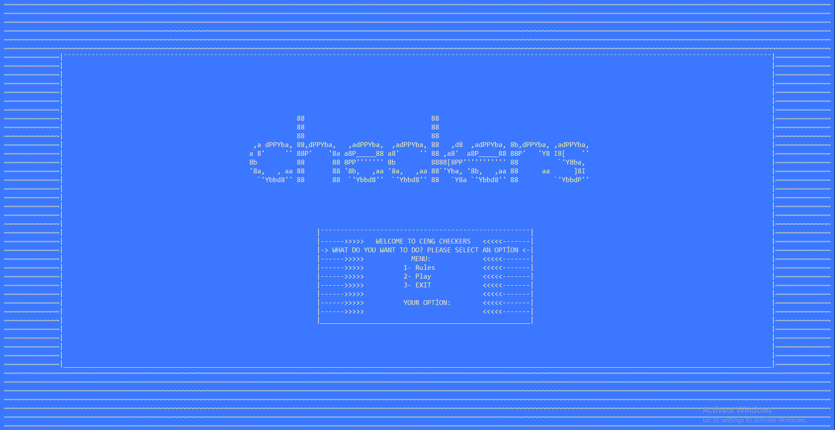

An efficient menu.(Rules, play, exit.)
A home screen enriched with visual objects.
A gameboard prepared using 4 colors.(White, Red, Black, Blue)
Additional Improvements

Slide 6

PROBLEMS ENCOUNTERED
Getting together in the first week.
Computer movements.

Slide 7

ALGORITHMS AND SOLUTION STRATEGIES
1- Creating gameboard.
2- Menu.
3- Computer movements.
4- Determination of the winner.

Slide 8
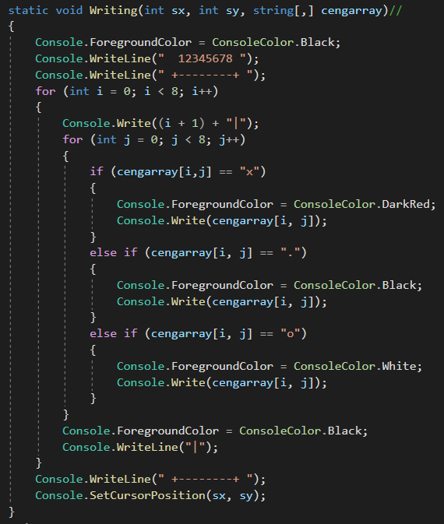
ALGORITHMS AND SOLUTION STRATEGIES - 1
We printed the gameboard with two nested “for loops”.
We printed the fixed numbers and frame using “Console.Writeline”.

Slide 9
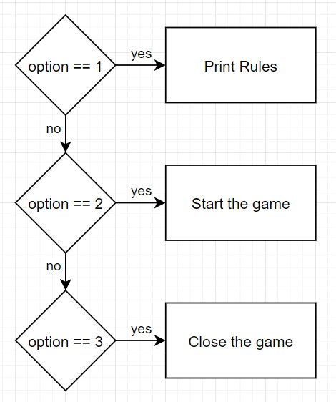
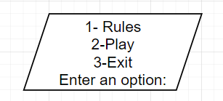
ALGORITHMS AND SOLUTION STRATEGIES - 2
Menu operations in main functions:
We created the menu using a self-written menu functions and use if blocks in the main.
Menu function gives 3 options to user and take an input.
Menu Function:

Slide 10
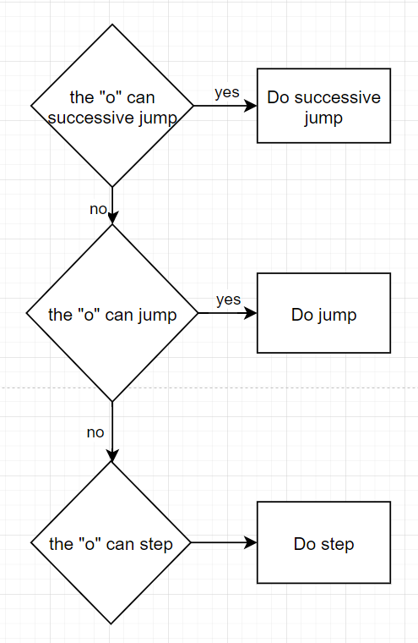
ALGORITHMS AND SOLUTION STRATEGIES - 3
We provided the same control and performed the action for all computer pieces
While determining the piece to be played, we used two nested for loop and moved the piece that provided first movable piece.

Slide 11
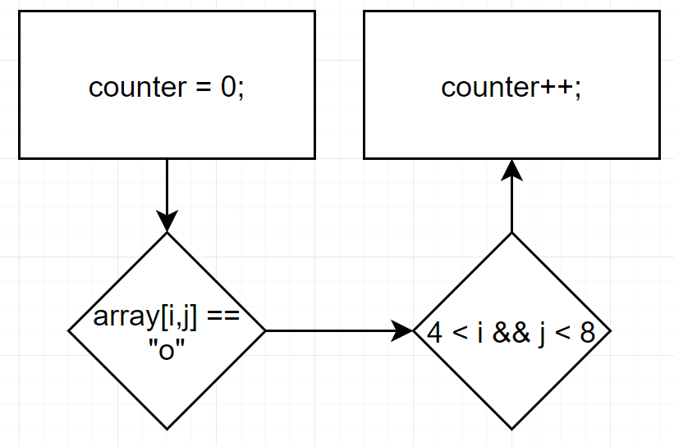
ALGORITHMS AND SOLUTION STRATEGIES - 4
Winner functions scans elements in the array and their position, and calculates the number of elements in the certain position.
If the number of elements in the certain position is 9 the functions determines the winner.

Slide 12


conclusıon
Working together effectively
C# Arrays and C#Functions

Slide 13
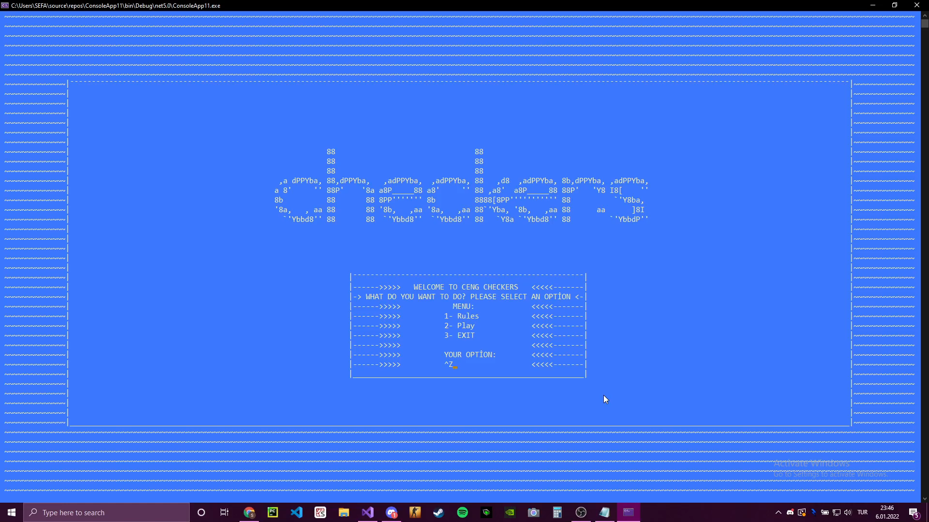

Slide 14

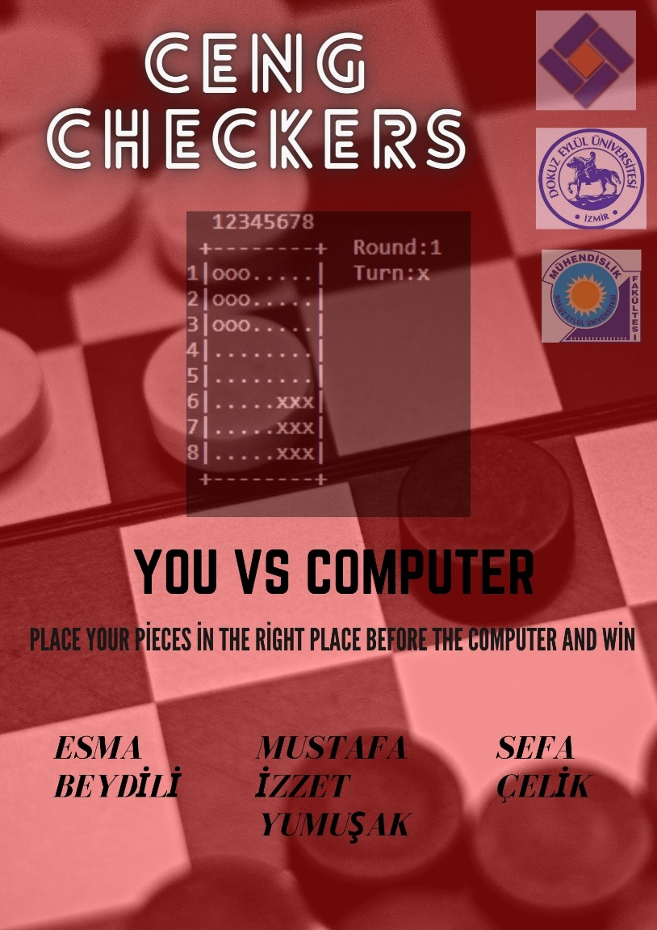
REFERENCES
https://docs.microsoft.com/id-id/dotnet/csharp/methods
https://www.w3schools.com/cs/cs_arrays.php
https://www.w3schools.com/cs/cs_methods.php
https://ascii.co.uk/art/checkers

Slide 15


